Slide 1
Continue >>
01 >>
FLAVORDASH:
IUT’S DELIVERY HUB
Structured Programming Lab Project
“ Final Presentation ”

Slide 2



<< Previous
Next >>
02 >>
FLAVORDASH
OUR TEAM
Nafis Sameen
220041150
Rawad Hossain
220041152
Asif Hasan
220041156

Slide 3
PROJECT INTRODUCTION
<< Previous
Next >>
03 >>
FLAVORDASH
FLAVORDASH: IUT’S DELIVERY HUB

Slide 4
INTRODUCTION
<< Previous
Next >>
04 >>
FLAVORDASH:
IUT’S DELIVERY HUB
FlavorDash is a C-based food management delivery system that brings our campus's savory essence right to your door. Enjoy a feast of flavors curated specifically for the IUT community, combining convenience and culinary excellence.
FlavorDash delivers a taste of IUT's flavors to you. Enjoy meals and delights curated specifically for you.

Slide 5
<< Previous
Next >>
05 >>
FLAVORDASH
{
FEATURES AND FUNCTIONALITIES
}

Slide 6
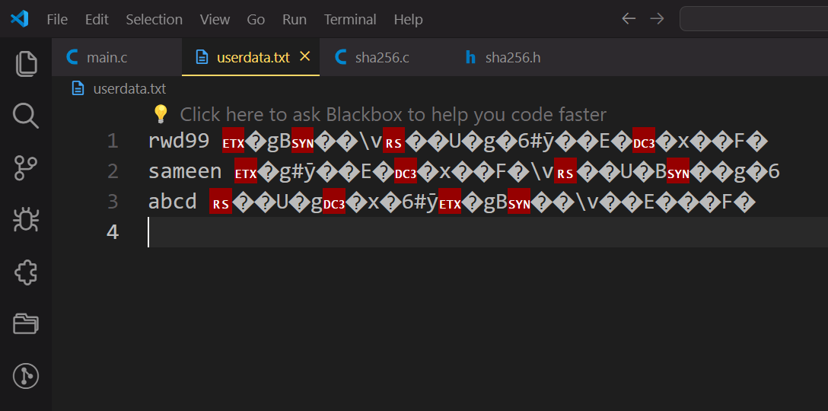
TOOLS & TECHNOLOGY
<< Previous
Next >>
06 >>
Sign up & Login feature
User can Sign up, Login using username and password
Protects password of user using “sha256” hashing technique
Notes:
This C code utilizes several external libraries and system-specific functions. Here's a breakdown:
1. **Standard Libraries**:
- `<stdio.h>`: Standard Input/Output functions like `printf`, `scanf`, etc.
- `<stdlib.h>`: Standard Library functions like dynamic memory allocation (`malloc`, `free`), exit functions (`exit`), etc.
- `<string.h>`: String manipulation functions like `strcpy`, `strcat`, etc.
- `<conio.h>`: Header providing console input/output functions. Note that `<conio.h>` is not standard and is specific to some compilers like Turbo C++ and Borland C++.
- `<windows.h>`: Header providing functions for interacting with the Windows operating system, like console manipulation functions (`cls`, `Sleep`), etc.
- `<time.h>`: Header providing functions for date and time manipulation (`__DATE__`).
2. **Control System**:
- The code employs control flow constructs such as `if`, `else if`, `else`, `while`, `do-while`, and `goto` statements for decision making and looping.
3. **Custom Functions**:
- There are several custom functions defined in the code, such as `insertfirst`, `insertmid`, `insertend`, `deletefood`, `updatefood`, `countitem`, `foodlist`, `order_view`, `main_menu`, `loadingbar`, `backuploader`, `middle1`, `middtab1`, `pwellcome`, `echo`, `br`, `pre`, `span`, `ccolor`, etc.
4. **Specific Functions**:
- Functions like `getch`, which waits for a character input without echoing it to the screen, and `SetConsoleTextAttribute` for changing console text color are used.
5. **Specific Tools**:
- The code utilizes specific features like console manipulation for layout/design purposes.
6. **Platform Dependency**:
- The code seems to be developed for Windows platforms due to the use of Windows-specific headers and functions (`<windows.h>`).
Overall, this code is specific to the Windows platform and may not be directly portable to other operating systems without modification. Additionally, it relies on certain non-standard features like `<conio.h>`, making it less portable across different compilers and environments.

Slide 7
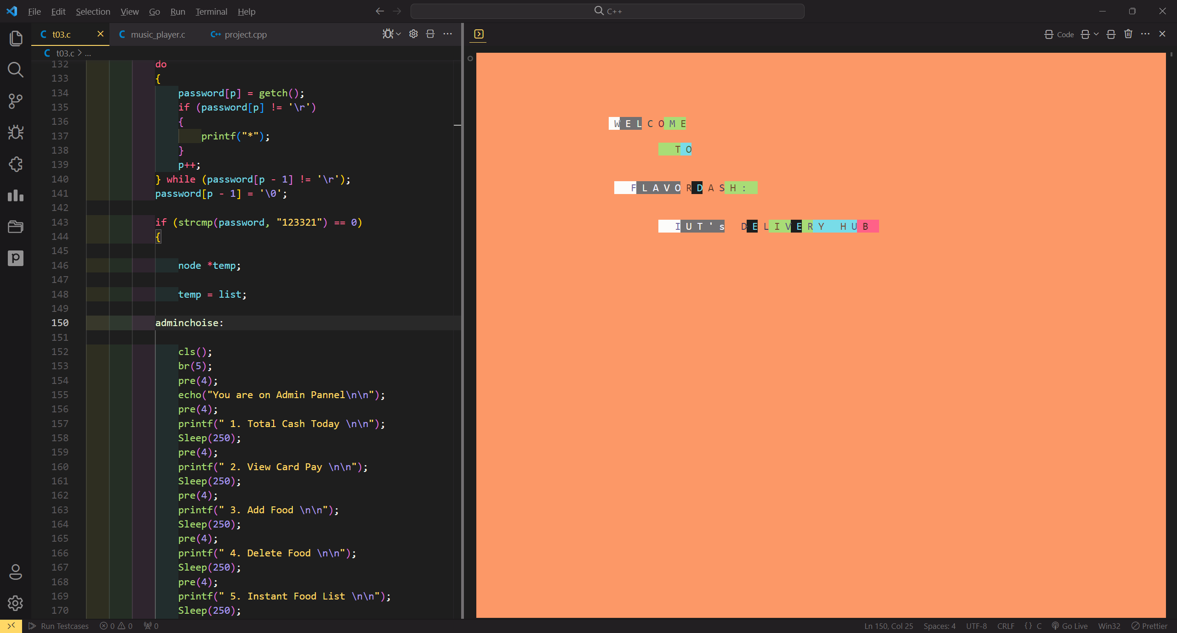
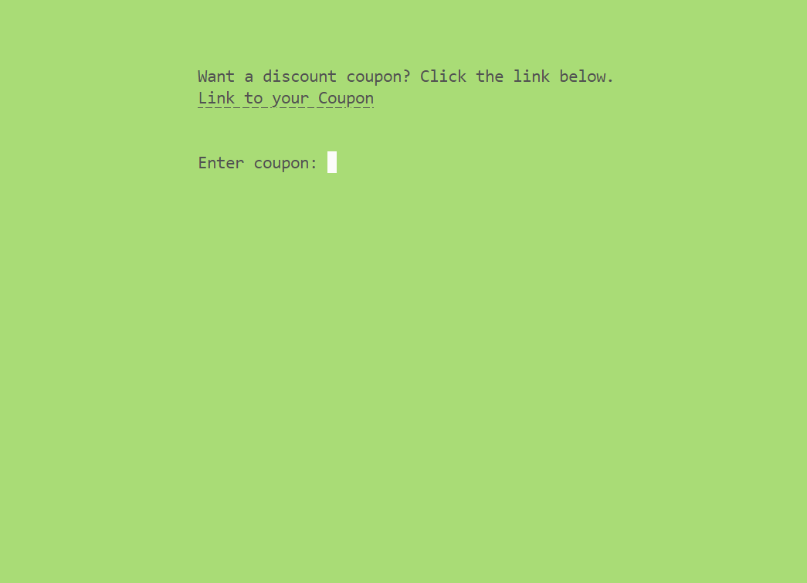
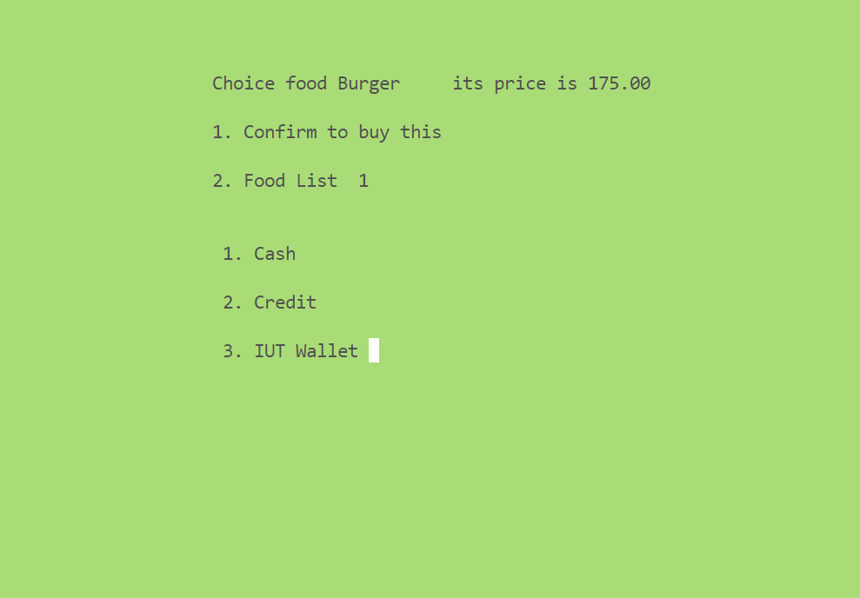
TOOLS & TECHNOLOGY
<< Previous
Next >>
07 >>
Payment Methods
User has three modes of payment;
Cash, Credit and IUT Wallet
Notes:
This C code utilizes several external libraries and system-specific functions. Here's a breakdown:
1. **Standard Libraries**:
- `<stdio.h>`: Standard Input/Output functions like `printf`, `scanf`, etc.
- `<stdlib.h>`: Standard Library functions like dynamic memory allocation (`malloc`, `free`), exit functions (`exit`), etc.
- `<string.h>`: String manipulation functions like `strcpy`, `strcat`, etc.
- `<conio.h>`: Header providing console input/output functions. Note that `<conio.h>` is not standard and is specific to some compilers like Turbo C++ and Borland C++.
- `<windows.h>`: Header providing functions for interacting with the Windows operating system, like console manipulation functions (`cls`, `Sleep`), etc.
- `<time.h>`: Header providing functions for date and time manipulation (`__DATE__`).
2. **Control System**:
- The code employs control flow constructs such as `if`, `else if`, `else`, `while`, `do-while`, and `goto` statements for decision making and looping.
3. **Custom Functions**:
- There are several custom functions defined in the code, such as `insertfirst`, `insertmid`, `insertend`, `deletefood`, `updatefood`, `countitem`, `foodlist`, `order_view`, `main_menu`, `loadingbar`, `backuploader`, `middle1`, `middtab1`, `pwellcome`, `echo`, `br`, `pre`, `span`, `ccolor`, etc.
4. **Specific Functions**:
- Functions like `getch`, which waits for a character input without echoing it to the screen, and `SetConsoleTextAttribute` for changing console text color are used.
5. **Specific Tools**:
- The code utilizes specific features like console manipulation for layout/design purposes.
6. **Platform Dependency**:
- The code seems to be developed for Windows platforms due to the use of Windows-specific headers and functions (`<windows.h>`).
Overall, this code is specific to the Windows platform and may not be directly portable to other operating systems without modification. Additionally, it relies on certain non-standard features like `<conio.h>`, making it less portable across different compilers and environments.

Slide 8

TOOLS & TECHNOLOGY
<< Previous
Next >>
08 >>
Discount Coupon Feature
User can get discount coupon through a link, redirecting to a discount web page
Want a discount coupon? Click link below.
Link to your coupon
Coupon: FLAVOR10
Total : $100
10% discount applied…
Total : $90
Press 1 to continue…
Notes:
This C code utilizes several external libraries and system-specific functions. Here's a breakdown:
1. **Standard Libraries**:
- `<stdio.h>`: Standard Input/Output functions like `printf`, `scanf`, etc.
- `<stdlib.h>`: Standard Library functions like dynamic memory allocation (`malloc`, `free`), exit functions (`exit`), etc.
- `<string.h>`: String manipulation functions like `strcpy`, `strcat`, etc.
- `<conio.h>`: Header providing console input/output functions. Note that `<conio.h>` is not standard and is specific to some compilers like Turbo C++ and Borland C++.
- `<windows.h>`: Header providing functions for interacting with the Windows operating system, like console manipulation functions (`cls`, `Sleep`), etc.
- `<time.h>`: Header providing functions for date and time manipulation (`__DATE__`).
2. **Control System**:
- The code employs control flow constructs such as `if`, `else if`, `else`, `while`, `do-while`, and `goto` statements for decision making and looping.
3. **Custom Functions**:
- There are several custom functions defined in the code, such as `insertfirst`, `insertmid`, `insertend`, `deletefood`, `updatefood`, `countitem`, `foodlist`, `order_view`, `main_menu`, `loadingbar`, `backuploader`, `middle1`, `middtab1`, `pwellcome`, `echo`, `br`, `pre`, `span`, `ccolor`, etc.
4. **Specific Functions**:
- Functions like `getch`, which waits for a character input without echoing it to the screen, and `SetConsoleTextAttribute` for changing console text color are used.
5. **Specific Tools**:
- The code utilizes specific features like console manipulation for layout/design purposes.
6. **Platform Dependency**:
- The code seems to be developed for Windows platforms due to the use of Windows-specific headers and functions (`<windows.h>`).
Overall, this code is specific to the Windows platform and may not be directly portable to other operating systems without modification. Additionally, it relies on certain non-standard features like `<conio.h>`, making it less portable across different compilers and environments.

Slide 9
TOOLS & TECHNOLOGY
<< Previous
Next >>
09 >>
Admin Panel feature
Can access Admin Pannel
Multiple functionalities like, checking cash amount, add-remove food item, backing up data
Admin Panel
-----------
Total Cash
View Card Pay
Add Food
Remove Food
View Food List
Item Counter
System Backup
Order Preview
Order Preview
0. Menu
Notes:
This C code utilizes several external libraries and system-specific functions. Here's a breakdown:
1. **Standard Libraries**:
- `<stdio.h>`: Standard Input/Output functions like `printf`, `scanf`, etc.
- `<stdlib.h>`: Standard Library functions like dynamic memory allocation (`malloc`, `free`), exit functions (`exit`), etc.
- `<string.h>`: String manipulation functions like `strcpy`, `strcat`, etc.
- `<conio.h>`: Header providing console input/output functions. Note that `<conio.h>` is not standard and is specific to some compilers like Turbo C++ and Borland C++.
- `<windows.h>`: Header providing functions for interacting with the Windows operating system, like console manipulation functions (`cls`, `Sleep`), etc.
- `<time.h>`: Header providing functions for date and time manipulation (`__DATE__`).
2. **Control System**:
- The code employs control flow constructs such as `if`, `else if`, `else`, `while`, `do-while`, and `goto` statements for decision making and looping.
3. **Custom Functions**:
- There are several custom functions defined in the code, such as `insertfirst`, `insertmid`, `insertend`, `deletefood`, `updatefood`, `countitem`, `foodlist`, `order_view`, `main_menu`, `loadingbar`, `backuploader`, `middle1`, `middtab1`, `pwellcome`, `echo`, `br`, `pre`, `span`, `ccolor`, etc.
4. **Specific Functions**:
- Functions like `getch`, which waits for a character input without echoing it to the screen, and `SetConsoleTextAttribute` for changing console text color are used.
5. **Specific Tools**:
- The code utilizes specific features like console manipulation for layout/design purposes.
6. **Platform Dependency**:
- The code seems to be developed for Windows platforms due to the use of Windows-specific headers and functions (`<windows.h>`).
Overall, this code is specific to the Windows platform and may not be directly portable to other operating systems without modification. Additionally, it relies on certain non-standard features like `<conio.h>`, making it less portable across different compilers and environments.

Slide 10
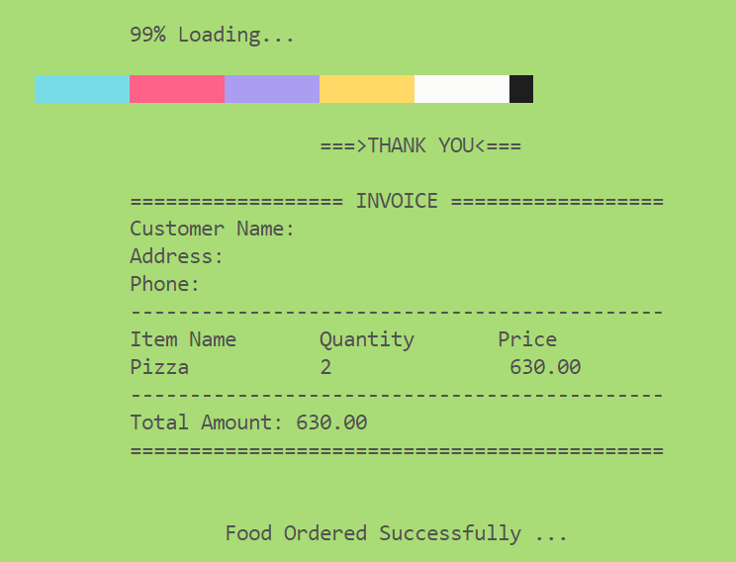
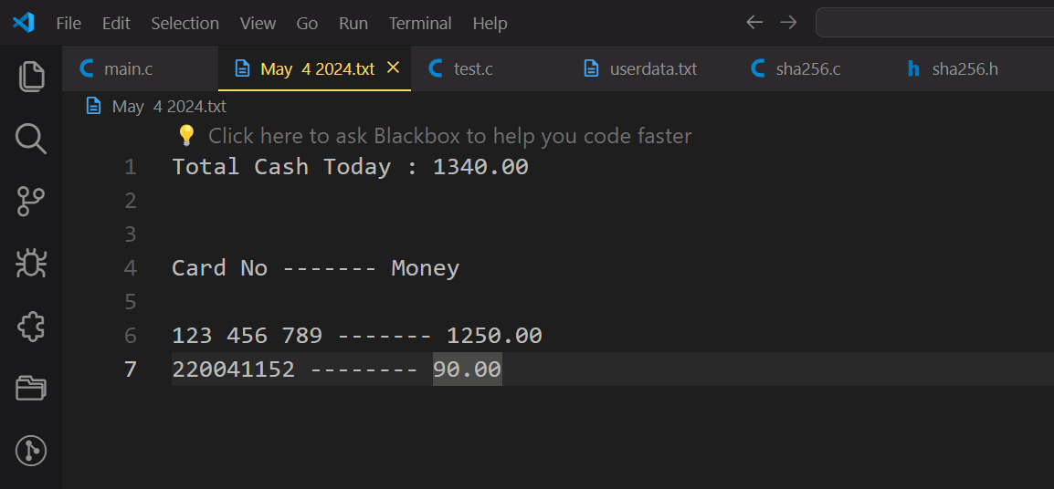
TOOLS & TECHNOLOGY
<< Previous
Next >>
10 >>
Data Backup & Invoice
Admin can backup the data of daily transactions
Backup information can be stored in separate txt file date wise
Rahim
IUT, Gazipur
0171132145
Notes:
This C code utilizes several external libraries and system-specific functions. Here's a breakdown:
1. **Standard Libraries**:
- `<stdio.h>`: Standard Input/Output functions like `printf`, `scanf`, etc.
- `<stdlib.h>`: Standard Library functions like dynamic memory allocation (`malloc`, `free`), exit functions (`exit`), etc.
- `<string.h>`: String manipulation functions like `strcpy`, `strcat`, etc.
- `<conio.h>`: Header providing console input/output functions. Note that `<conio.h>` is not standard and is specific to some compilers like Turbo C++ and Borland C++.
- `<windows.h>`: Header providing functions for interacting with the Windows operating system, like console manipulation functions (`cls`, `Sleep`), etc.
- `<time.h>`: Header providing functions for date and time manipulation (`__DATE__`).
2. **Control System**:
- The code employs control flow constructs such as `if`, `else if`, `else`, `while`, `do-while`, and `goto` statements for decision making and looping.
3. **Custom Functions**:
- There are several custom functions defined in the code, such as `insertfirst`, `insertmid`, `insertend`, `deletefood`, `updatefood`, `countitem`, `foodlist`, `order_view`, `main_menu`, `loadingbar`, `backuploader`, `middle1`, `middtab1`, `pwellcome`, `echo`, `br`, `pre`, `span`, `ccolor`, etc.
4. **Specific Functions**:
- Functions like `getch`, which waits for a character input without echoing it to the screen, and `SetConsoleTextAttribute` for changing console text color are used.
5. **Specific Tools**:
- The code utilizes specific features like console manipulation for layout/design purposes.
6. **Platform Dependency**:
- The code seems to be developed for Windows platforms due to the use of Windows-specific headers and functions (`<windows.h>`).
Overall, this code is specific to the Windows platform and may not be directly portable to other operating systems without modification. Additionally, it relies on certain non-standard features like `<conio.h>`, making it less portable across different compilers and environments.

Slide 11
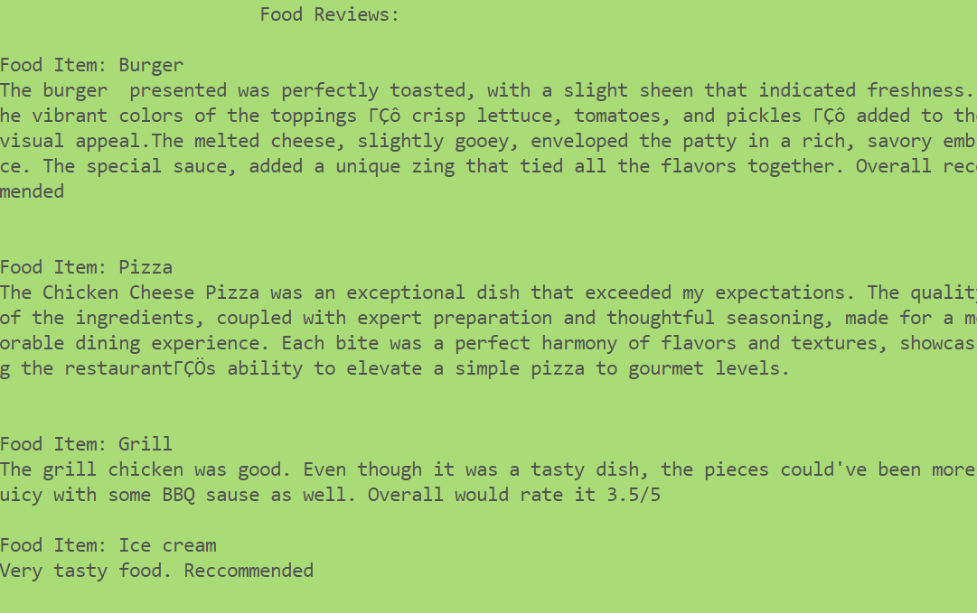
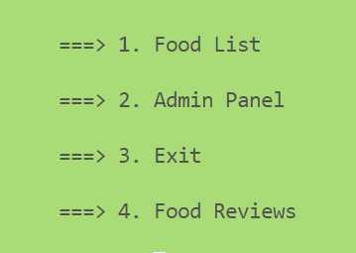
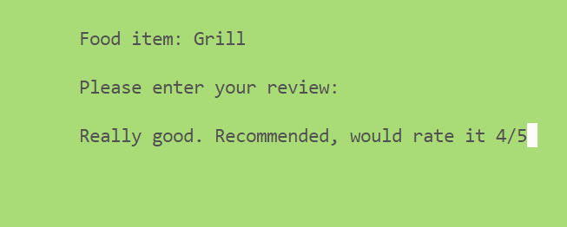
TOOLS & TECHNOLOGY
<< Previous
Next >>
11 >>
Review System
Admin can backup the data of daily transactions
Rahim
Rahim
IUT, Gazipur
IUT, Gazipur
0171132145
0171132145
Notes:
This C code utilizes several external libraries and system-specific functions. Here's a breakdown:
1. **Standard Libraries**:
- `<stdio.h>`: Standard Input/Output functions like `printf`, `scanf`, etc.
- `<stdlib.h>`: Standard Library functions like dynamic memory allocation (`malloc`, `free`), exit functions (`exit`), etc.
- `<string.h>`: String manipulation functions like `strcpy`, `strcat`, etc.
- `<conio.h>`: Header providing console input/output functions. Note that `<conio.h>` is not standard and is specific to some compilers like Turbo C++ and Borland C++.
- `<windows.h>`: Header providing functions for interacting with the Windows operating system, like console manipulation functions (`cls`, `Sleep`), etc.
- `<time.h>`: Header providing functions for date and time manipulation (`__DATE__`).
2. **Control System**:
- The code employs control flow constructs such as `if`, `else if`, `else`, `while`, `do-while`, and `goto` statements for decision making and looping.
3. **Custom Functions**:
- There are several custom functions defined in the code, such as `insertfirst`, `insertmid`, `insertend`, `deletefood`, `updatefood`, `countitem`, `foodlist`, `order_view`, `main_menu`, `loadingbar`, `backuploader`, `middle1`, `middtab1`, `pwellcome`, `echo`, `br`, `pre`, `span`, `ccolor`, etc.
4. **Specific Functions**:
- Functions like `getch`, which waits for a character input without echoing it to the screen, and `SetConsoleTextAttribute` for changing console text color are used.
5. **Specific Tools**:
- The code utilizes specific features like console manipulation for layout/design purposes.
6. **Platform Dependency**:
- The code seems to be developed for Windows platforms due to the use of Windows-specific headers and functions (`<windows.h>`).
Overall, this code is specific to the Windows platform and may not be directly portable to other operating systems without modification. Additionally, it relies on certain non-standard features like `<conio.h>`, making it less portable across different compilers and environments.

Slide 12
<< Previous
Next >>
12 >>
FLAVORDASH
QR Code feature for Discount Coupon
Integrating Multiple Vendors option for user

Slide 13
<< Previous
Next >>
13 >>
FLAVORDASH
{
TOOLS AND TECHNOLOGIES
Libraries and
Functions
}

Slide 14
TOOLS & TECHNOLOGY
<< Previous
Next >>
14 >>
External Libraries & Functions
stdio.h: Standard Input/Output functions
stdlib.h: Standard Library functions like dynamic memory allocation, conversions, exit etc.
string.h: string manipulation functions
conio.h: Console Input/Output functions specific to windows
windows.h: Interacting with windows operating system, like console manipulation functions for layout/design purposes
sha256.h : Implementing Hashing Technique for masking password of the user
Notes:
This C code utilizes several external libraries and system-specific functions. Here's a breakdown:
1. **Standard Libraries**:
- `<stdio.h>`: Standard Input/Output functions like `printf`, `scanf`, etc.
- `<stdlib.h>`: Standard Library functions like dynamic memory allocation (`malloc`, `free`), exit functions (`exit`), etc.
- `<string.h>`: String manipulation functions like `strcpy`, `strcat`, etc.
- `<conio.h>`: Header providing console input/output functions. Note that `<conio.h>` is not standard and is specific to some compilers like Turbo C++ and Borland C++.
- `<windows.h>`: Header providing functions for interacting with the Windows operating system, like console manipulation functions (`cls`, `Sleep`), etc.
- `<time.h>`: Header providing functions for date and time manipulation (`__DATE__`).
2. **Control System**:
- The code employs control flow constructs such as `if`, `else if`, `else`, `while`, `do-while`, and `goto` statements for decision making and looping.
3. **Custom Functions**:
- There are several custom functions defined in the code, such as `insertfirst`, `insertmid`, `insertend`, `deletefood`, `updatefood`, `countitem`, `foodlist`, `order_view`, `main_menu`, `loadingbar`, `backuploader`, `middle1`, `middtab1`, `pwellcome`, `echo`, `br`, `pre`, `span`, `ccolor`, etc.
4. **Specific Functions**:
- Functions like `getch`, which waits for a character input without echoing it to the screen, and `SetConsoleTextAttribute` for changing console text color are used.
5. **Specific Tools**:
- The code utilizes specific features like console manipulation for layout/design purposes.
6. **Platform Dependency**:
- The code seems to be developed for Windows platforms due to the use of Windows-specific headers and functions (`<windows.h>`).
Overall, this code is specific to the Windows platform and may not be directly portable to other operating systems without modification. Additionally, it relies on certain non-standard features like `<conio.h>`, making it less portable across different compilers and environments.

Slide 15

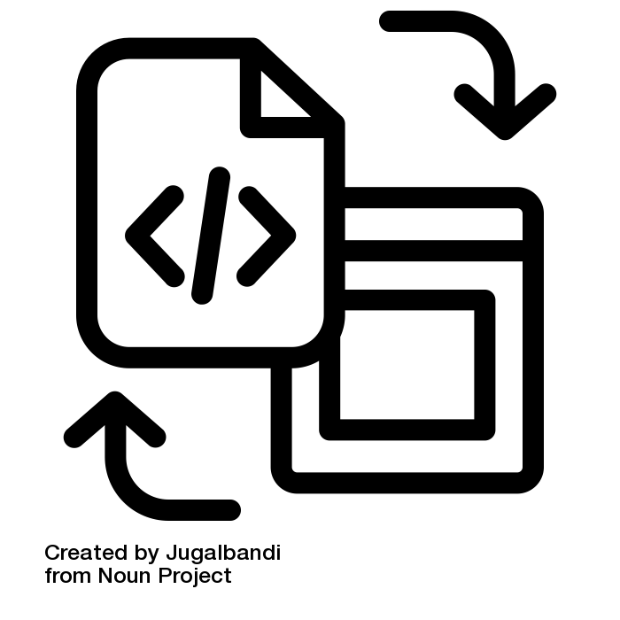
<< Previous
Next >>
15 >>
FLAVORDASH
TASK DISTRIBUTION

Slide 16
TASK CONTRIBUTION
<< Previous
Next >>
16 >>
Creative Analyst
Coding
Ensures Consistency and Coherence in design elements
Coding
Scripting & making project presentation
User Interfaces and interactive elements for better experience
Communicate project concepts and ideas
Managed overall system and functions
Designs project elements and overall system
Testing & Debugging, resolve issues in codebase
Contributing in few features in the intro page
User Feedback, testing result & optimize user engagement
Implemented Hashing in login function
Contributing in few features
Implemented discount coupon, review feature
Sameen - 50
Rawad - 52
Asif - 56

Slide 17


<< The
End >>
17 >>
FLAVORDASH
THANK YOU!
FLAVORDASH:
IUT’S DELIVERY HUB
Team:
Rawad Hossain
Syed Nafis Sameen
Asif Hasan

